Slide 1
Graduate Orientation
CRS
COMMUNICATION + RHETORICAL STUDIES

Slide 2
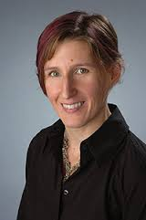
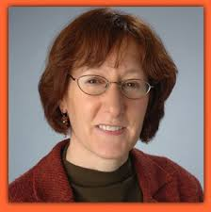
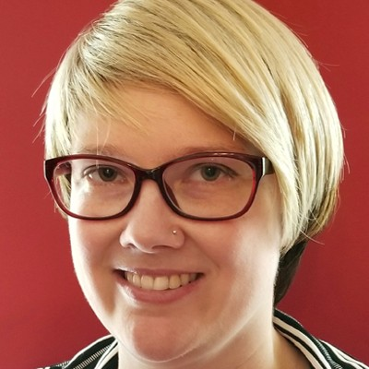
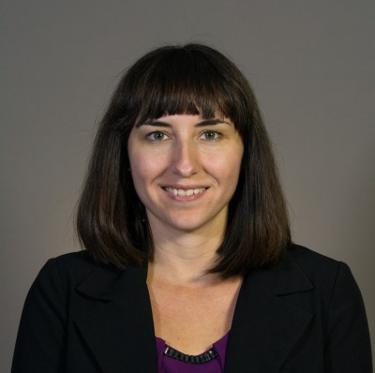
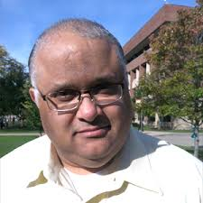
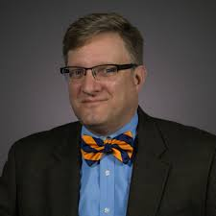
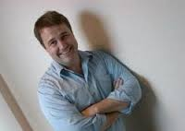
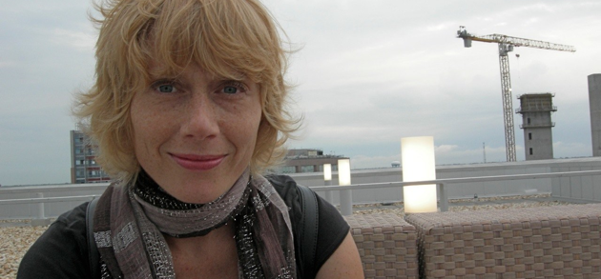
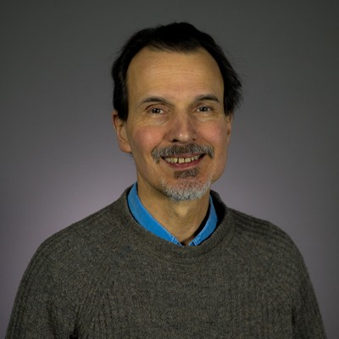
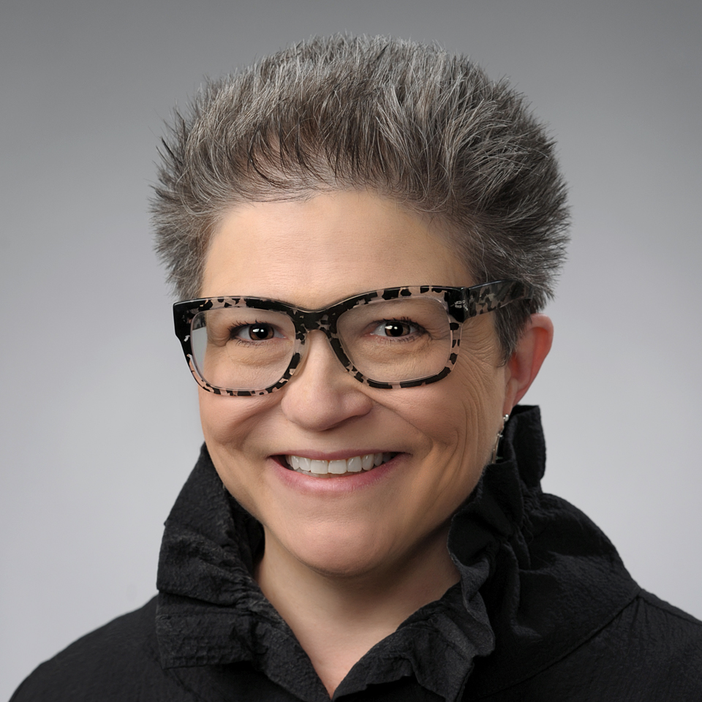
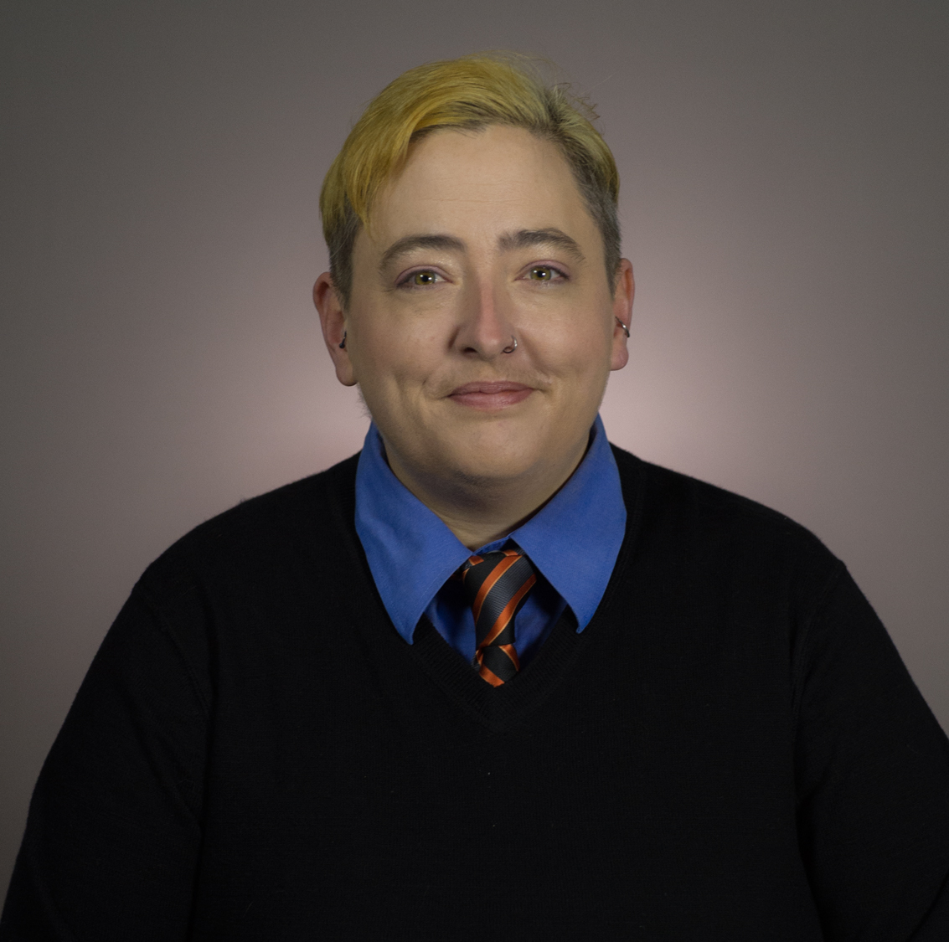
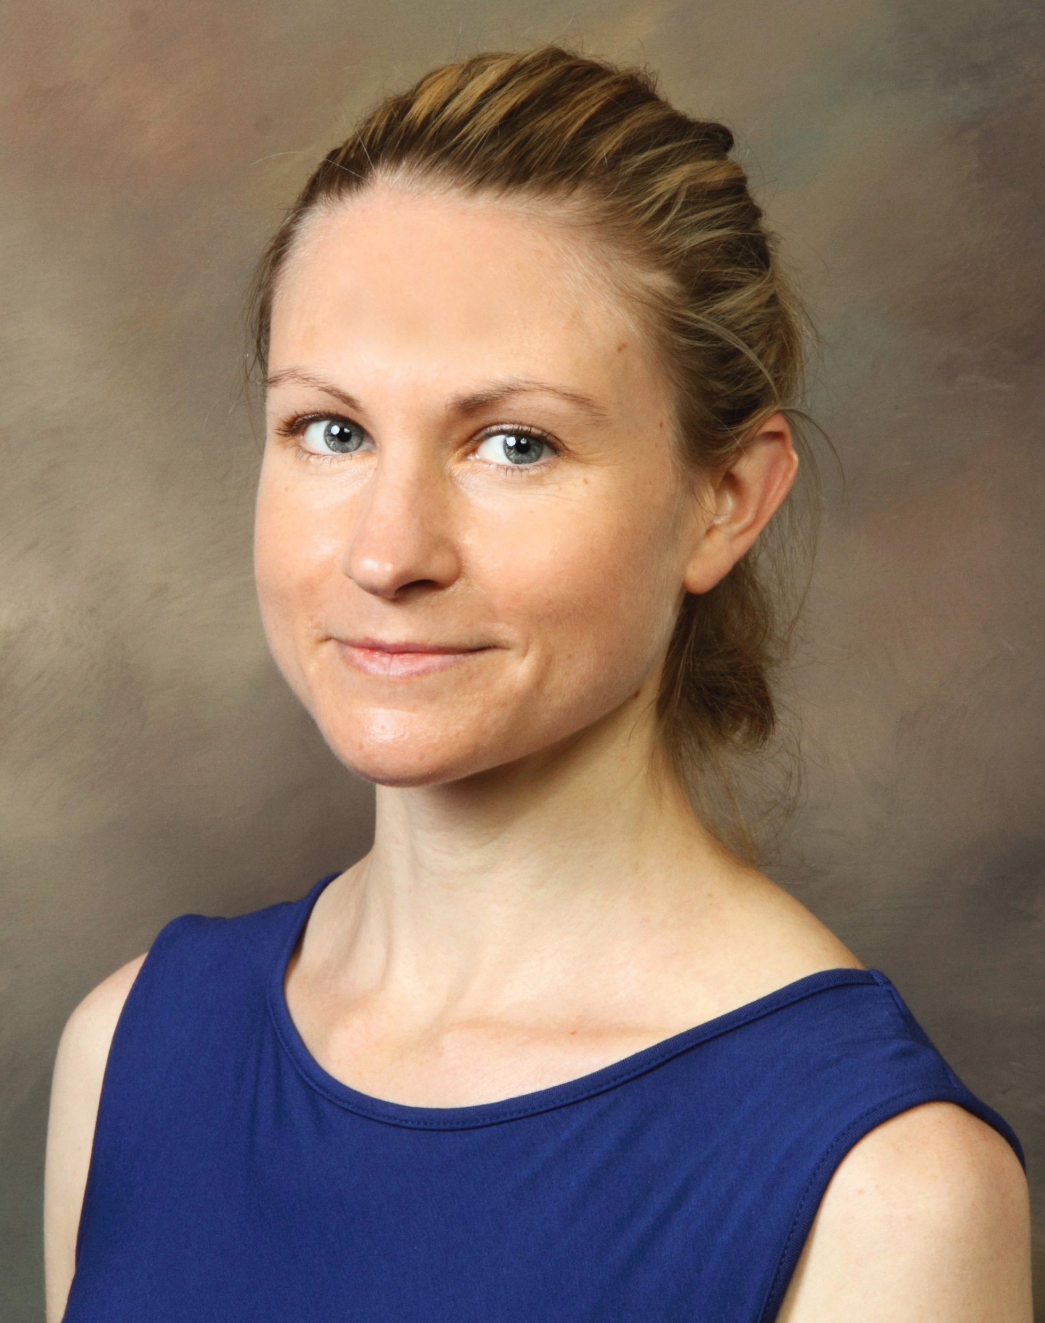
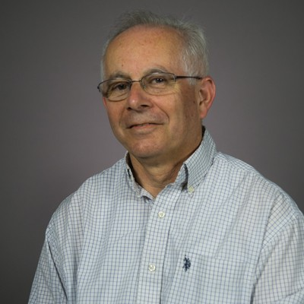
Graduate Faculty
Richard Buttny
Dana Cloud
Erin Rand
Katie Feyh
Lyndsay Gratch
Diane Grimes
Rachel Hall
Amos Kiewe
Charles Morris
Kendall Phillips
Whitney Phillips
Amardo Rodriguez
Sylvia Sierra

Slide 3
Resident Saints of Problem Solving
Sarah Francesconi
Joanne Balduzzi
Work study students
Do not abuse their generosity and goodwill.

Slide 4
Curriculum Overview
Areas of Study
Language and Social Interaction
Rhetorical Criticism, Theory, History
Critical/Cultural Communication
Visual Culture
Digital Communication and Social Media

Slide 5
Language & Social Interaction/Discourse Analysis
Sylvia Sierra, “Buffy sings to Cody”: A multimodal analysis of mother and pre-lingual-infant question–response sequences. Journal of Pragmatics, 110 (2017): 50-62.
“Playing out loud: Videogame texts as resources in friend interaction for managing frames, epistemics, and group identity. Language in Society 45(2) 2016:217-245.
Richard Buttny, "Contesting hydrofracking during an inter-governmental hearing: Accounting by reworking or challenging the question,” Discourse & Communication 2015

Slide 6
Rhetorical Theory, Criticism,
History
Amos Kiewe, Confronting Anti-Semitism: Seeking an End to Hateful Rhetoric. Leicester, UK: Troubador Publishing Ltd.
Charles E. Morris III, “Context’s Critic, Invisible Traditions, and Queering Rhetorical History”; Queering Public Address: Columbia, Univ. South Carolina Press, 2007.
Erin Rand, "An Appetite for Activism: Lesbian Avengers and the Queer Politics of Visibility"; Reclaiming Queer: Activist and Academic Rhetorics of Resistance. Tuscaloosa: University of Alabama Press, 2014.
Dana Cloud, Reality Bites: Rhetoric and the Circulation of Truth Claims in U.S. Political Culture. Columbus: Ohio State University Press, 2018.
Dana Cloud & Kathleen Feyh, “Reason and Revolt: Emotional Fidelity and Class Standpoint in ‘The Internationale,” Rhetoric Society Quarterly 2015.

Slide 7
Critical/Cultural
Communication and Visual Culture
Amardo Rodriguez, Communication: Colonization and the Making of a Discipline.
Kendall Phillips, A Dark Place: The Rhetoric of Horror in Early American Cinema. Austin: University of Texas Press, 2018.
Rachel Hall, The Transparent Traveler: The Performance and Culture of Airport Security. Durham: Duke University Press, 2015.
Diane Grimes, "Reproducing and Resisting Whiteness in Organizations, Policies, and Places," Social Politics, 17 (2010).

Slide 8
Digital, Online, and Social Media
Whitney Phillips, This is Why We Can’t Have Nice Things: Mapping the Relationship Between Online Trolling and Mainstream Culture, Cambridge: MIT Press, 2016.
Lindsay Michalik Gratch, Adaptation Online: Creating Memes, Sweding Movies, and Other Digital Performances, Lanham, MD: Lexington Books, 2017.

Slide 9
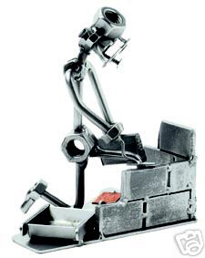

Credit Hours
Good Standing
Exit Options
Nuts & Bolts

Slide 10
Credit Hours
33 credit hours to graduate
24 hours in CRS (15 hrs at 600 level or above; up to 6 hrs independent study allowed)
Required:
CRS 601 Proseminar in Communication
CRS 603 Contemporary Theories of Rhetoric
9 hours outside the department

Slide 11
"Good Standing"
CRS GPA of "B" (3.0) or better
Overall GPA of "B-" (2.67) or better
Full-Time Status Must Be Maintained

Slide 12
Exit Options
(For extended descriptions, see Grad Manual.)
Thesis: 75-125-page research project; 6 credits in addition to 27 hours of coursework. If proposal not finished in 3rd semester, comp exams assumed.
Comprehensive Exams: 33 credit hours required; exam over material in 601 and 603, and an area of your choosing.

Slide 13
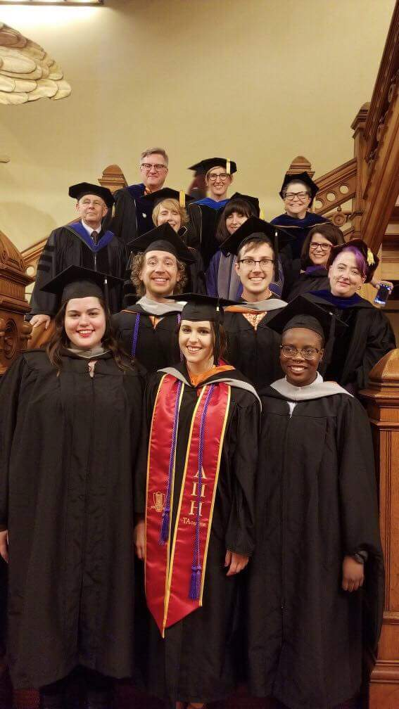
Degree Timeline
1st Fall: Required Coursework
Choose your advisor.
1st Spring: Elective Coursework; Advisor/committee; declare exit option
2nd Fall: Elective Coursework; Thesis Proposal Meeting
2nd Spring: Thesis Work or Coursework + Comprehensives

Slide 14
Graduate Assistantships
Contractual Obligation (20 hrs. service per week)
Conditions for Annual Renewal (appropriate degree progress; satisfactory performance; availability of resources; professional conduct)

Slide 15
Resources
Future Professoriate Program (FPP): 2 yr. professional mentorship and development program leading to Certificate in University Teaching (and stipend!); monthly meetings and 2nd yr Teaching Portfolio req. [enrollment deadline coming up]
BlackBoard: "Communication and Studies Graduate Student Resources" (Access Code: crsgrads)
Colloquia
Conference Travel Support (per availability and competitive application)
CRTNET: Listserv of National Communication Association (www.natcom.org)
SU Graduate School (http://www.syr.edu/gradschool/index.html)
GSO (http://gradorg.syr.edu/)

Slide 16
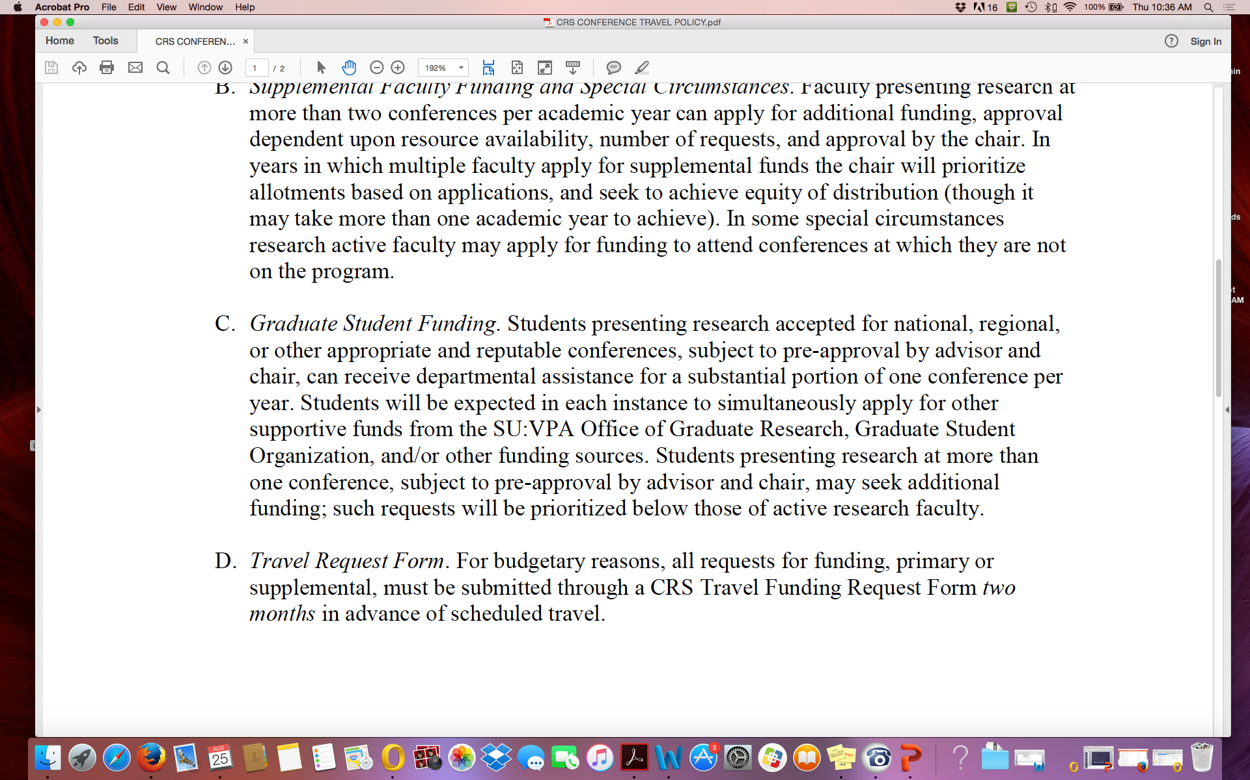
Travel policy

Slide 17
Graduate Student Resources Site
http://crsgrads.vpa.syr.edu/

Slide 18
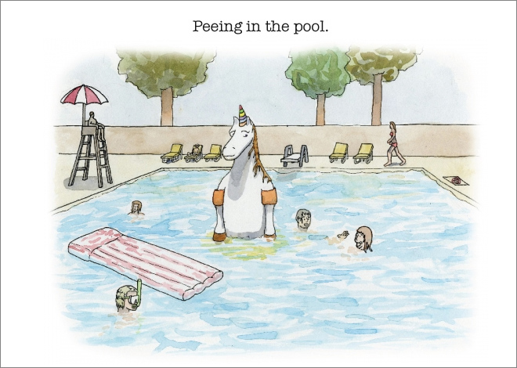
Principles for CRS Success!
No Jerks—Treat people with generosity, humility, patience, and gratitude.
Community
Perfectionism bad.
Manage Stress
Advisor
Deadlines and semester stress points
Focus
Self-care

